Slide 1


Slide 2
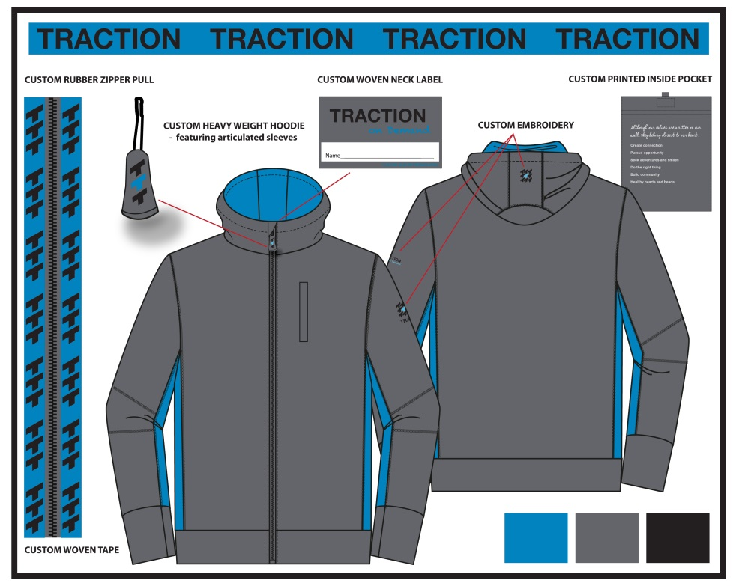
Why Custom Clothing?
Every business’ goal is to distinguish themselves apart from their competition.
Thinking outside of the box with your marketing budget is one of the top ways to do this.
By integrating custom apparel into your marketing plan can show that you are unique and creative.
Let Bishop Custom Clothing showcase your brand by showing you the benefits of custom apparel and how easy it can be.

Slide 3

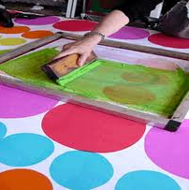
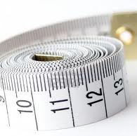

If you answer yes to any of the following 4 questions. Then you should be ordering a custom wearable!
Do you want to include your corporate color into your garment?
Your exact Pantone color
Why? Because your logo will look like it belongs
Do you want to incorporate decorations that can not be done on finished garments?
Printed linings, customized neck tape, private label
Accent colors on small panels or piping
Decoration over seams
Do you want to get the sizing that you and your team want?
Up to size 8XL
Talls & Shorts
Sized specifically for your needs
Sizes that fit your people
Do you want to expand your selection?
Find your ideal garment at retail
Find your ideal garment on a website
Design your ideal garment

Slide 4


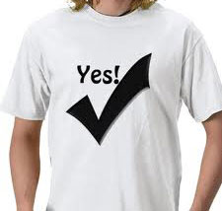
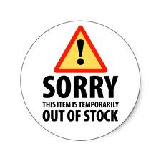
Why you should order custom clothing?
You want to create a garment authentic to your brand with garments in your colors, with your decoration, that fit like you need them to!
To stand out from your competition!
Never having to say no, or I can’t find it!
Get what you want, the way you want it and need it!
The ability to create long term wearable programs without the fear of the item being discontinued…….ever!

Slide 5
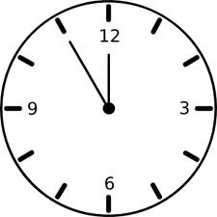
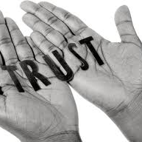
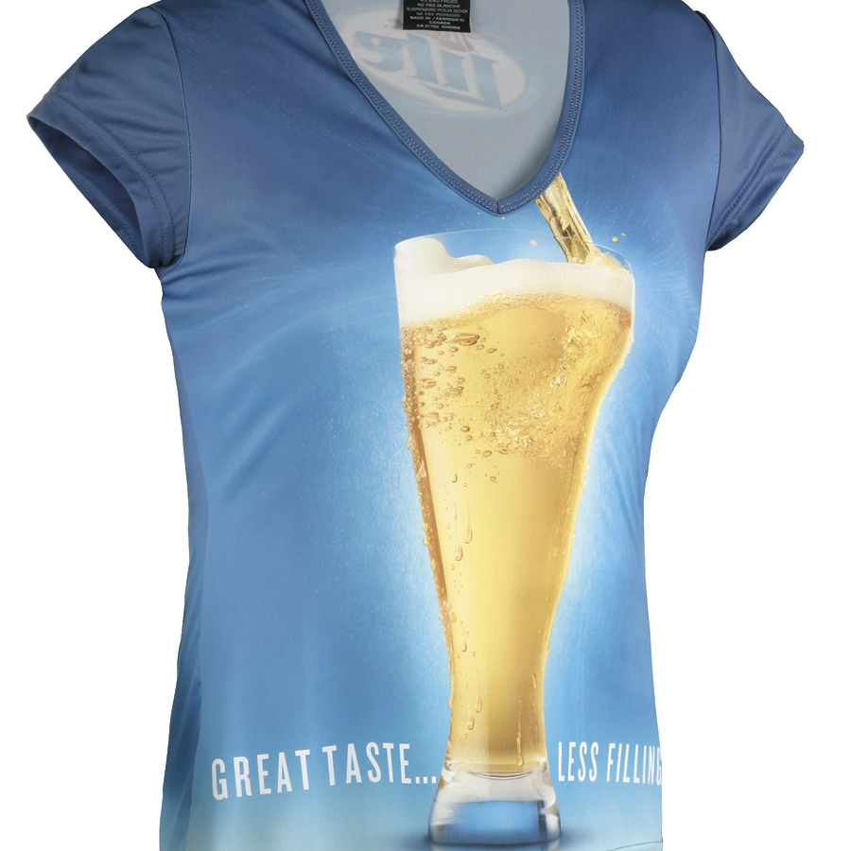
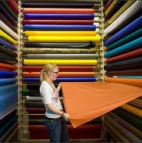
Why choose Bishop Custom Clothing?
Custom clothing is all we do and we are faster than everyone else!
Domestic (Canada & USA)
48 piece minimum for Bishop styles.
2-4 week turn around time.
Shipped FOB WA state.
Offshore:
300 Piece minimum orders.
8-14 week delivery.
Shipped FOB WA state.
Bishop inspects 100% of all shipments made in our Offshore partner factories.
Bishop stands behind everything that they sell 100%.
Bishop works with some of the best subcontractors in the business.
Sublimation Printing
Silk Screening
Embroidery
Vinyl Heat Transfer
Appliqué
Custom Label
Rubber Patches
Emboss & Engraving
Rhinestones
Fiberlok
Bishop is an expert at fabric sourcing.
Knits
Wovens
Leather
Circular knits
Eco-friendly fabrics
Waterproof breathable & bonded fabrics
Technical wicking & antimicrobial fabrics

Slide 6
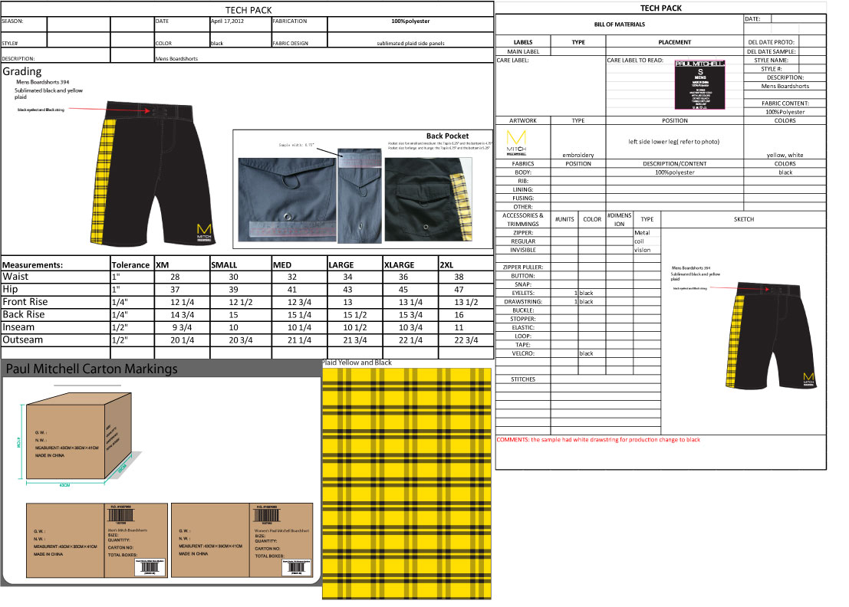
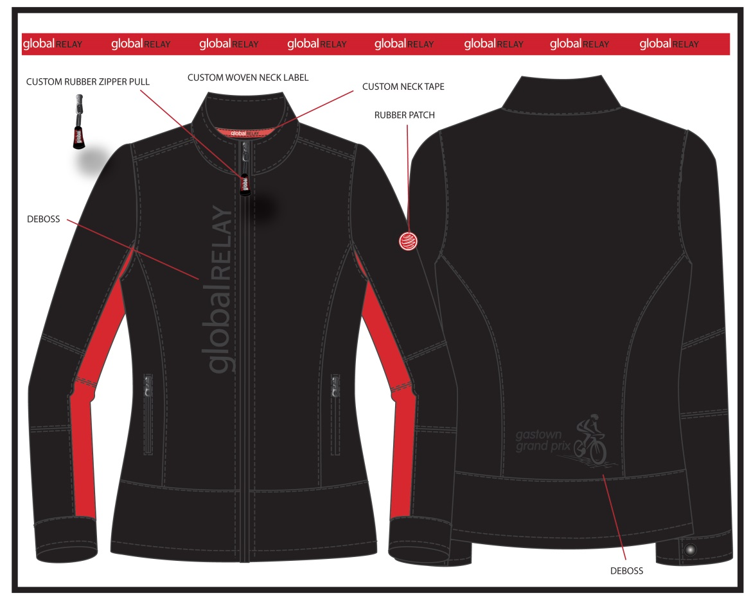
Special Services
We can create it for you!
Our own pattern makers.
Our own tech packs detailing every element of the garment.
The ability to produce samples or pre-production samples domestically and quickly.
Provide you with virtual mock ups.

Slide 7
